Slide 1

Literature Review of
Predicting ADHD from Handwriting
Md Bikasuzzaman
Dept. of Information and Communication Technology
Islamic University, Bangladesh
Supervised By:
Fadoua Drira
&
Rim Walha

Slide 2

The Authors of [1] used handwriting-based ADHD detection in children with ASD. This study will assist medical practitioners/physicians in detecting children with ADHD who have Autism Spectrum Disorder(ASD) at an early stage, so that early detection can improve the quality of life for children with ADHD. To accomplish this, they collected 29 student handwriting samples from Japanese children. As the languages of different countries are not the same, so they attempt to determine handwriting patterns. For this study, they used seven Machine Learning-based algorithms (SVM, RF, DT, Gaussian Nave Bayes, K-Nearest Neighbors, Logistic Regression, and Extra Tree). The Sequential Forward Floating Search (SFFS) method was used to extract features from handwriting patterns. Finally, they get the best result for the RF-based algorithm, with 93.10% accuracy.

Slide 3

The authors of [2] used distinctive characteristics of handwriting in children with ADHD by analyzing physical characteristics and patterns, and they conclude that graphological analysis is an effective ADHD diagnostic tool for clinicians. They used 49 children (21 boys and 28 girls), with both types of children affected by ADHD or not. They conducted research on those children and discovered that force, timing of agonist and antagonist muscles, and pen pressure are all weaker in children with ADHD. They collected 10-12 line handwriting samples from children in a 20-minute period and compared those samples using graphology theory. They created a predefined handwriting profile of an individual with ADHD that includes 15 characteristics. For each characteristics has 1 point, and the graphology score range was from 0 to 15. Samples with a score of 9 or higher were considered to have ADHD.

Slide 4
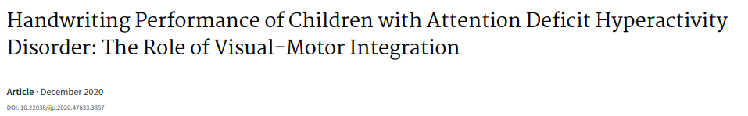
The authors of [3] concentrate their research on Visual-Motor Integration (VMI) for handwriting performance in children with Attention Deficit Hyperactivity Disorder. They conducted research on 24 children with ADHD and 24 healthy children of the same age. Children with ADHD and healthy children have the same writing speed but different legibility. Children with ADHD have difficulty with word formation. According to the findings of this study, healthy children had higher VMI scores than ADHD children.

Slide 5
Reference
[1] Shin, J., Maniruzzaman, M., Uchida, Y., Hasan, M.A.M., Megumi, A. and Yasumura, A., 2023. Handwriting-based ADHD Detection for Children Having ASD using Machine Learning Approaches. IEEE Access.
[2] Cohen, R., Cohen-Kroitoru, B., Halevy, A., Aharoni, S., Aizenberg, I. and Shuper, A., 2019. Handwriting in children with Attention Deficient Hyperactive Disorder: role of graphology. BMC pediatrics, 19(1), pp.1-6.
[3] Farhangnia, S., Hassanzadeh, R. and Ghorbani, S., 2020. Handwriting Performance of Children with Attention Deficit Hyperactivity Disorder: The Role of Visual-Motor Integration. International Journal of Pediatrics, 8(11), pp.12317-12326.

Slide 6
THANK YOU!!!

